Slide 1
Fact/Joke of the day!
By: Emma

Slide 2
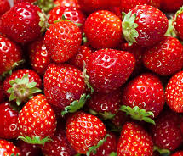
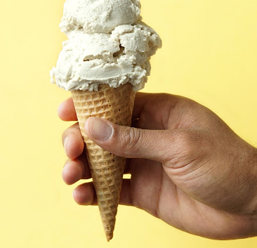
Fact
A strawberry is the only fruit with seeds on the outside!
Ice cream was once called “CREAM-ICE”

Slide 3
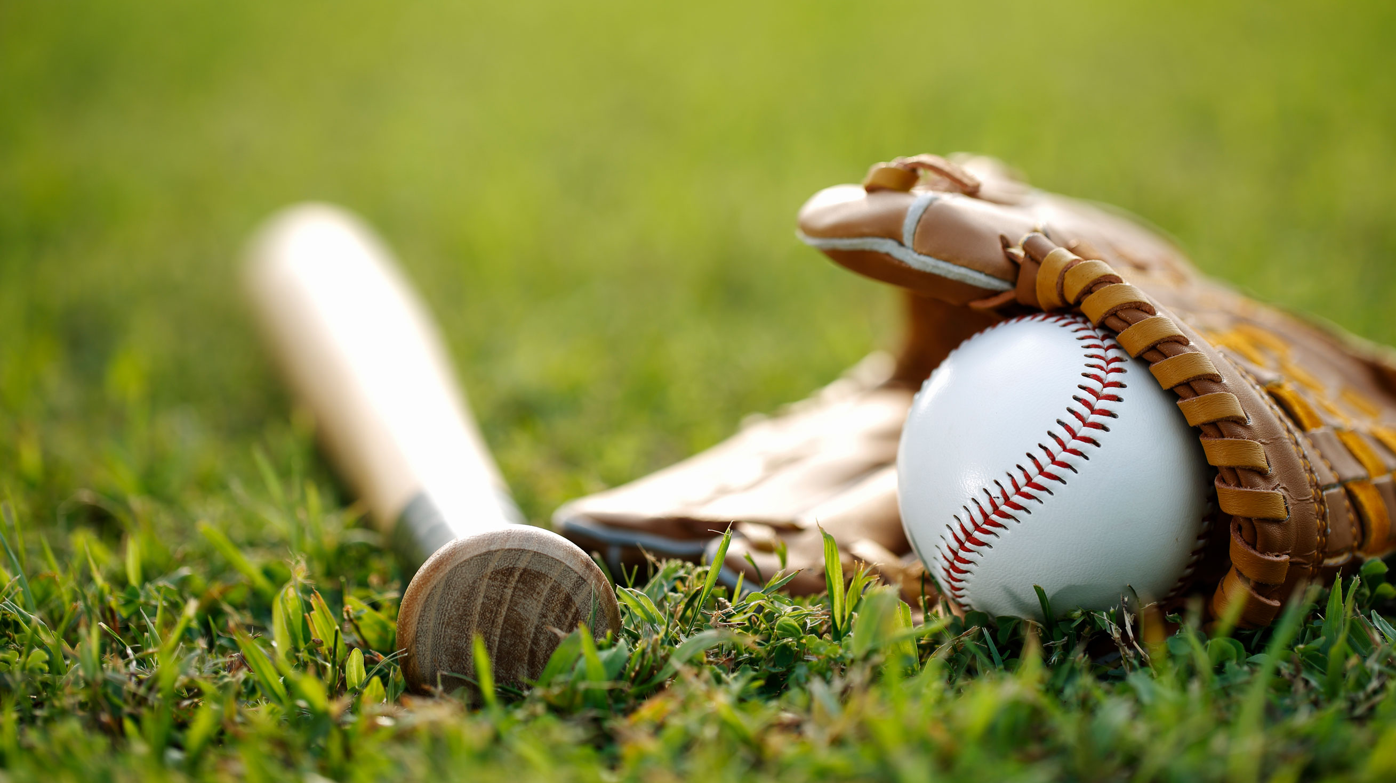
Joke
What animal is always at a baseball game?
(answer on next page)
Disclaimer: finding jokes that kids understand is difficult

Slide 4
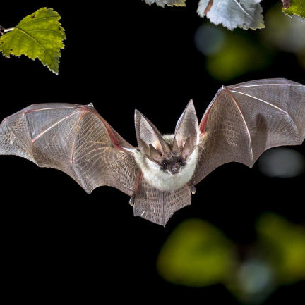
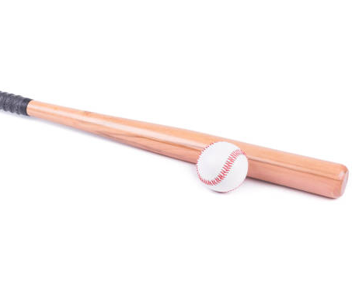
Joke Answer
A BAT!
Explanation: in baseball, they use a bat to hit the ball. A bat is also an animal.

